Slide 1
Complete the sentences.
1.他将会就如何徒步给出一些建议。
He will _______________________________ how to go walking.
2. 他们十分注意产品的质量。
They _________________________the quality of the products.
3. 你坐得离电视机太近了，这对你的眼睛不好。
You ____________________________, and it’s bad for your eyes.
4. 我发觉在春节期间买票是相当难的。
I find ______________ to buy a ticket during the Spring Festival.
5. 任何时候当你在山间行走，你都要小心落石.
_______________________________________________________.
6. 他以一首诗开始他的演讲。
He ________________________________.
7. 天气越来越冷了，你最好穿上毛衣。
It is _______________________. You’d better wear the sweater.
give some suggestions about / on
pay a lot of/much attention to
are sitting too close to the TV
it fairly difficult
Be careful of falling stones whenever you walk in the hills
began his speech with a poem
getting colder and colder

Slide 2
1. 看完电影后，他发现他的钱包不见了。
________________ the film, he found that his wallet was lost.
2. 我们在听他弹钢琴。
We are ____________________________________________.
3. 我们每天都看到他出去散步。
We __________________________ every day.
4. 我记得以前见过这个人。
I _____________________ the man before.
5. 记得拍一些漂亮的照片哦。
________________________ some beautiful photos.
6. 他伸手去够电话，打翻了一个杯子。
He ___________________ the phone and knocked over a glass.
7. 你最好在词典里查一下它。
You’d better ___________________ in the dictionary .
8. 他正一动不动地站在长城的城墙边。
He is __________________________________ the Great Wall.
9. 每当听到突然的声响，我都心惊胆战。
___________ there was _______________, my blood __________.
After seeing
listening to him playing the piano
see him go for a walk
remember seeing
Remember to take
reached out for
look it up
standing very still on the edge of
Every time
a sudden noise
went cold

Slide 3
10. 因为咳嗽，我直到3点才睡着。
I _______________________3 o’clock because of the cough.
11. 我们已经出发去上海了。
We have ______________Shanghai.
12. 你最好小心那只老虎，不要靠得它太近。
You ____________________________the tiger and not get too close to it.
13.我们常常在海边玩得很开心。
We often _________________________on the beach.
didn’t fall asleep until
set out for
had better be careful of
have fun playing

Slide 4
单项选择
1. －Don’t make a ___ in the library, Bill.
－Sorry, I won’t do that again.
A. voice B. noise C. sound D. singing
2. －Where’s Mr. Yu, do you know?
－Well, it’s hard to say. But I saw him ________ a football game just now.
A. was watching B. watching
C. had watched D. watched
3. I often see old women ____ in the square and they look happy.
A. was dancing B. dancing
C. dances D. dance
B
B
D

Slide 5
C
3. ―Do you still remember ______ me somewhere in Shanghai?
―Yes, of course. Two years ago.
A. to see B. see C. seeing D. saw
4. ― Mr Wang, I have trouble _____ the text.
―Remember _____ it three times at least.
A. to understand; reading
B. understanding; reading
C. understanding; to read
D. to understand; to read
5. We should pay attention ___ the classroom on time.
A. to clean B. clean C. of cleaning D. to cleaning
C
D

Slide 6
6. They arrived at Beijing ___ the afternoon on May 1st.
A. in B. to B. on D. at
7. ____ useful knowledge we learnt from him.
A. How a B. What an C. How D. What
8. You mustn’t go off on your own.
_____. I will follow you.
A. Yes, I won’t B. No, I will C. Yes, I will D. No, I won’t
9. Would you please ____ make a noise in the library?
A. don’t B. not C. not to D. to not
C
D
D
B

Slide 7
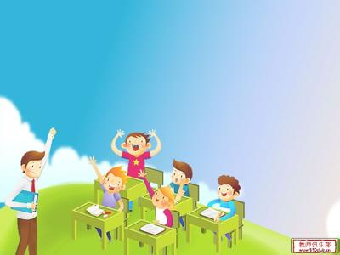
Module 4
Rules and suggestions
Unit 3 Language and use

Slide 8


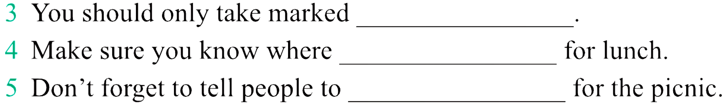


plan the walk
you are going to walk
clearly marked paths
paths
you can stop
bring food
too hot
very bad weather
new walk

Slide 9
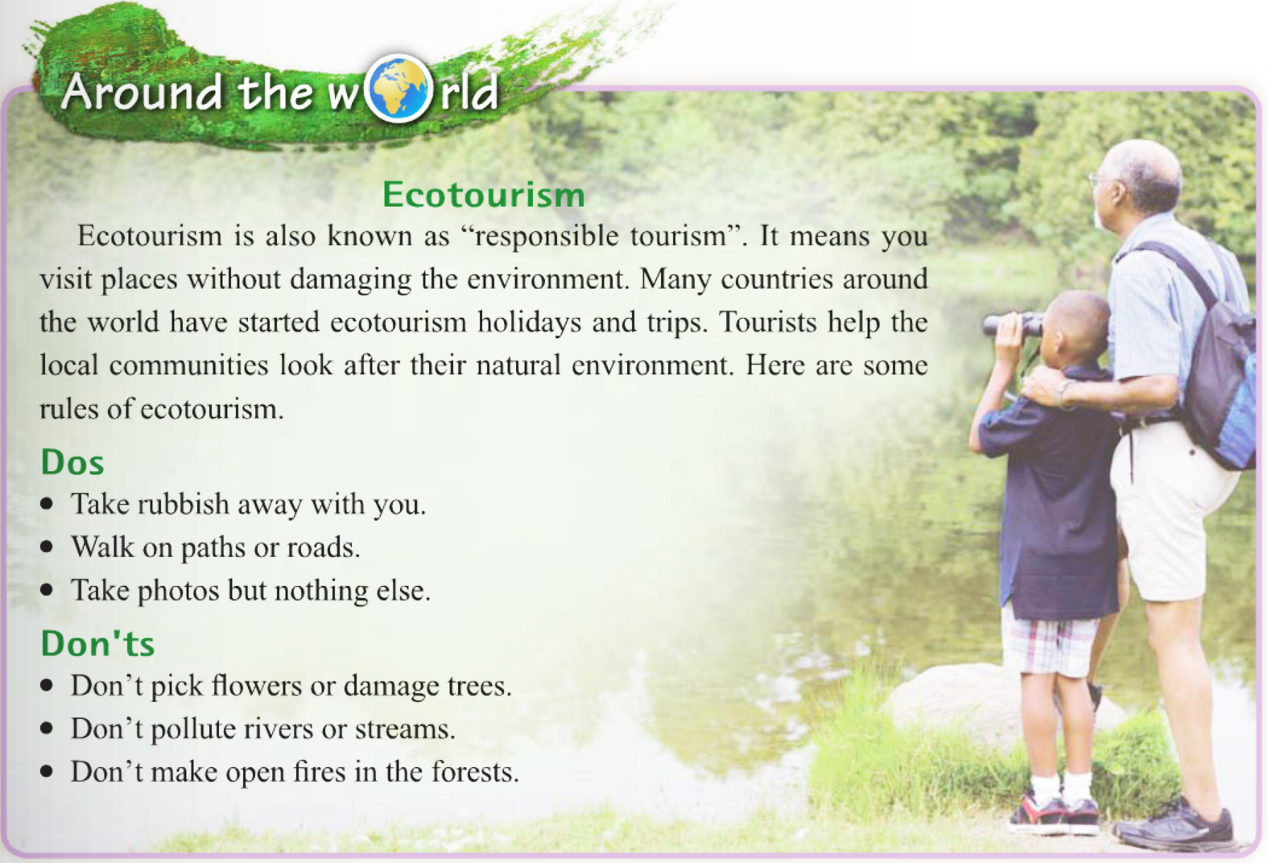
['i:kəʊtʊərɪzəm] 生态旅游

Slide 10
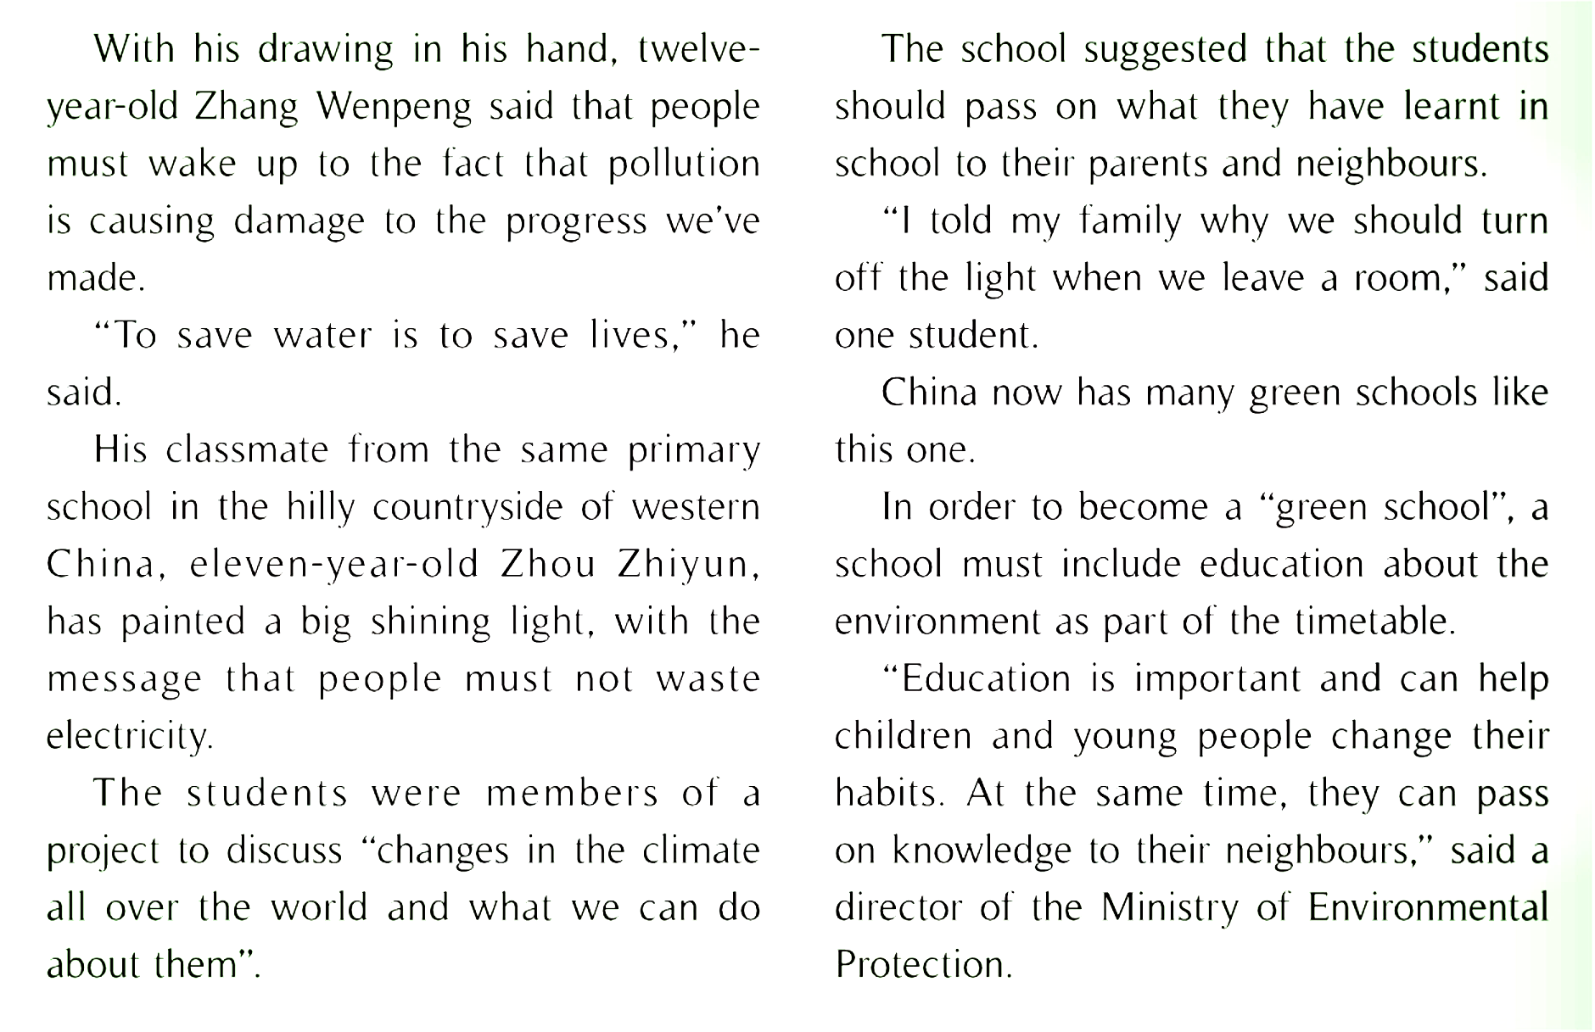

Slide 11
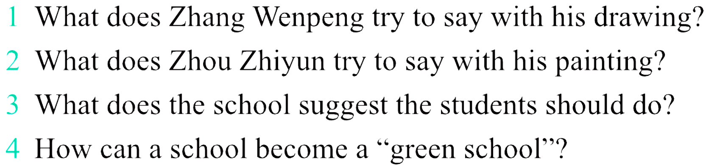
1. He tries to say that people must wake up to the fact that
pollution is causing damage to the progress we’ve made
with his drawing.
2. He is trying to say that people mustn’t waste electricity.
3. The school suggests that the students should pass on what
they have learnt in school to their parents and neighbours.
4. A school can become a “green school” by including education
about the environment as part of the timetable.

Slide 12
同位语从句
同位语从句

Slide 13
Activity 5.Complete the sentences with the words in the box.
gun smooth sticks stone sudden tent whenever
1.Come and visit me __________ you have time.
2.The wall is made of _________.
3.The path to the top is not very __________.
4.Remember to take a ______ with you to sleep in, because
it might rain.
5.He lifted up the _______ and pointed it at the
bear.
6.There was a ________ noise in the woods and we
all stopped moving.
7.Birds use small ________ and leaves to make a home.
whenever
stone(s)
smooth
tent
remember to do/ remember doing sth.
gun
sudden
sticks

Slide 14
Activity 4. Complete the passage with the correct form of the words in the box.
although keep stream tourist worry
People are very (1)________ about the conditions of the ancient forests of Canada and want to save them. Many visitors to the forests are use knives to cut their names into the trees, some of which are hundreds of years old. (2)_________ there are litter bins, people still throw rubbish into the (3)_______ and this causes plants and fish to die.
People from local villages have helped clean up the forests. We hope (4)_______ will play their part in (5)________ Canada’s forests clean too!
worried
Although
stream
tourists
keeping
Now write possible rules for visitors to the forests.
1.You should ___________________________________________.
2.You shouldn’t_________________________________________.
3.You must_____________________________________________.
4.You mustn’t___________________________________________.
put your rubbish into the litter bins.
throw your rubbish into the stream.
take care of the trees.
cut your names into the tress.

Slide 15
情态动词的用法P100
Language practice
1. 你们一定要小心落石。
You ______________________________falling stones.
2.你们不准走得太靠近山路的边缘，因为可能会摔伤自己。
You _______________ too close to the edge of the hill path because you _________________and hurt yourselves.
3.你们应该穿合适的衣服。
You ___________________________proper clothes.
4.灰熊可能会认为我们的垃圾是食物。
Bears ____________________our rubbish is food.
5. ----我们可以去攀岩吗？ ----不可以。
---- ________________rock climbing?
---- No, you____________.
must be careful of
mustn’t walk
might fall
should always wear
might think
Can we go
can’t

Slide 16
Grammar: Modal Verb
情态动词

Slide 17
Summarize the usage of the modal verbs.
1. can& could
1.—___ I speak to Mr. Wang, please?
—Sorry, he isn’t in now.
can B. might C. must
答案：A
Can表示“允许，同意，能，会，可以，有时会”
Could是can的过去式，有时候可以用于提出委婉的请求,此时的could没有过去的意思。
Eg. Could you tell me your telephone number?
--Yes, I can. / -- No, I can’t. （注意不可以用could)
其他回答：Yes, I’d love to./ Sure./ Of course./ Certainly
I’m afraid not.
Can表示“可能”，一般用于否定句和疑问句中。
Tom _____ be at home, he went to the cinema with his friends just now.
must B. mustn’t C. can’t
答案：C

Slide 18
表猜测性的情态动词有：may ， can’t ， must 。
may表没把握的猜测。
can’t 表有把握的否定猜测。
must 表有把握的肯定猜测。
B
1.The light in the office is off. The teacher ______be there now.
A. may B. can’t C. mustn’t D. must
2.His parents bought him a large house . It ____be very expensive.
A. must B. can C. mustn’t D. can’t
3. ----Where is Kate?
----I’m not sure. She ___ in the reading room.
A. maybe B. may be C. must be D. is
4. This book ___ Lily’s because her name is on it.
A. must is B. must be C. can be D. can’t be
A
B
B

Slide 19
2. may& might
—May I come in?
—Yes, you _____/ —No, you _____
may, may B. could, can’t C. may, can’t
答案：C
may表示“可能，可能性”，常用语肯定句中说明说话人同意许可或请求对方许可。
Might是may的过去式
以may开头进行的提问。回答：
Yes，please/Yes, you can/may.
No, you’d better not/ can’t/mustn’t.
Eg. Teachers ____ also make mistakes if they aren’t carful.
A. must B. may C. may be D. have to
B

Slide 20
3. must& have to
must还表示 主观看法表“必须，应该” ,
否定时表“禁止”
用于第一人称(I/we)表示义务、有必要
Cars ________________when the traffic light change to red.
2)用于第二、三人称表示命令和要求
你在阅览室要保持安静
You must keep quiet in the reading room.
Must用于一般疑问句时，回答通常是：
Yes, you must. / No, you needn’t./ No, you don’t have to.
have to 是表示说话人的客观看法，强调客观要求，
各种人称和数的变化.
Eg. I would like to go to the party, but I ___ finish my homework.
A. must B. have to C. mustn’t D. can’t
must stop
B

Slide 21
need 既可作情态动词，又可作实意动词。
need做情态动词，后接动词原形，主要用于否定或疑句中。
need作实意动词，后接名词，代词或动词不定式，有人称、时态和数的变化。
他无需担心这件事。
He needn’t worry about it.
He doesn’t need to worry about it.
我们需要告诉他真相。
We need to tell him the truth.
Eg. You ____ go with us.
A. don’t need B. needn’t to
C. don’t need to
C

Slide 22
其他的情态动词
shall 应该（否定式shan’t/shall not）表示义务、许诺
should 应该(否定式shouldn’t )表示义务、推测
你不应该看不起别人。
You shouldn’t look down on others.
will (过去式为would) 决心，愿望，would也可以用于现在时，语气比较委婉。
注意：will you…?/Would you like…?表示肯定含义的请求劝说时，疑问句中一般用some.

Slide 23
表示请求对方做某事或劝告
1）Will/ Would/ Could you (please do sht./ please not do sth?
你可以帮我拿这个手提箱吗？
Would you please help me with the suitcase?
你可以不要玩电脑游戏吗？
Would you please not play computer games?
Sorry, I won’t.
2) Would you mind (sb.) doing sth…?
你介意吧音乐关小点儿声吗？ 好的。
---Would you mind turning down the music?
---No, not at all./ Sorry, I’ll turn it down.
3) had better (not) do sth.
你最好不要去人员密集的地方。
You’d better not go somewhere crowded.

Slide 24
Practice
1. -- _____ you come with me to Lang Lang’s piano concert this evening?
-- I’d love to, but I have to study for my math test.
A. Should B. May C. Must D. Can
2. --I saw Kevin in the supermarket this morning.
--No, it __ him. He moved to Canada last week
A. can be B. must be
C. can’t be D. mustn’t be
3. --My shoes are worn out. --____.
A. Can’t they be mended? B. Let me have a look at it.
C. How much do they cost? D. Can’t they mended?
4.--Is Mr. Smith in his office now?
--No, he ___ there. I ___ him in the library a minute ago.
A. may be, see B. can’t be, see
C. mustn’t be, saw D. can’t be, saw
5. --___ you turn down your radio, please? -- Yes, I can.
A. May B. Need C. Must D. Can

Slide 25
6. Everyone ____ go through the security check(安检) when entering the World Expo Park.
A. can B. may C. must D. ought
7.-Can I wear any clothes I like to school?
-No, you can’t. You __ wear a uniform.
A. might B. must C. will D. would
8. –How was the youth club last night, Mark?
--It was great fun. You ___ come.
A. must B. can C. should D. may
9.—It’s such a long way! What shall I do?
--You ____ take my car if you want.
A. will B. must C. may D. shall
10.—What will the weather be like tomorrow?
--It ___ be rainy, cloudy or sunny. Who knows?
A. must B. might C. shall D. should

Slide 26
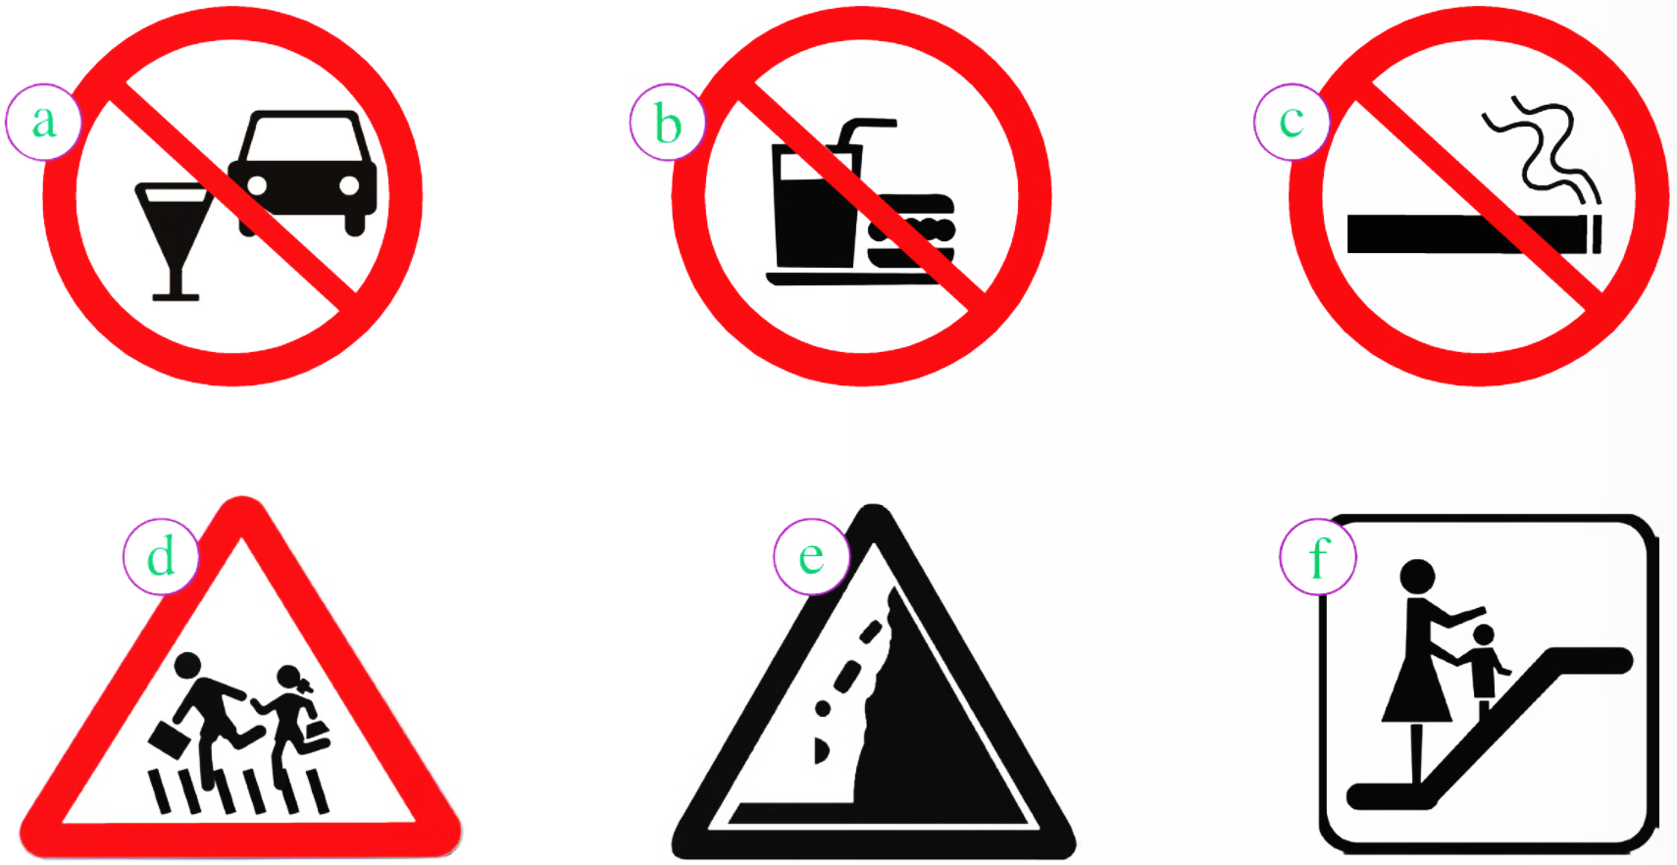

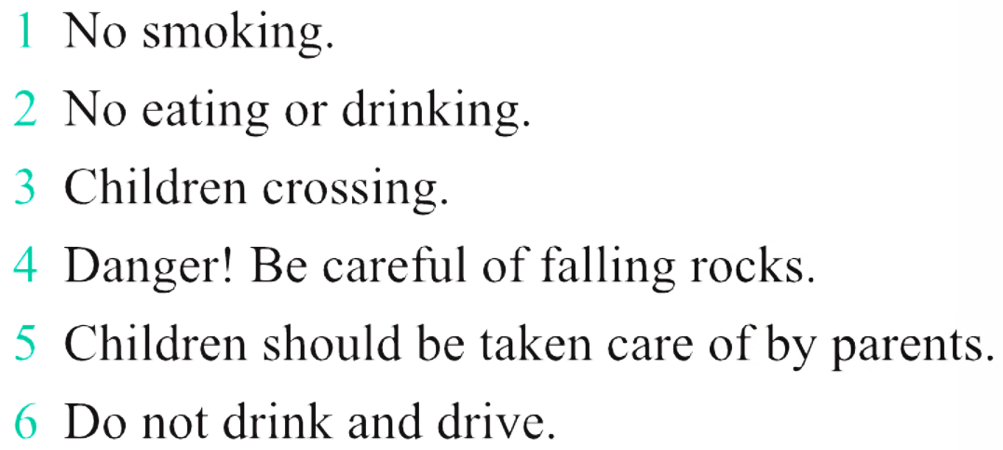
c
b
d
e
f
a
禁止酒驾。

Slide 27
Activity 2. Read the list of rules and write sentences using must, mustn’t should or shouldn’t.
Visitors please note:
Dos
Check in at the main gate
when you come to the
centre.
Climb with some one.
Wear a hard hat at all times.
Wear the correct climbing
shoes.
Wear comfortable clothes.
Don’ts
Don’t climb without rope.
Don’t eat or drink anywhere
except in the restaurant.
Don’t listen to personal
music player while climbing.
Don’t talk on a mobile
phone while climbing.
Eg. You must check in at the main gate when
you come to the centre.
You mustn’t climb without rope.

